Slide 1
COCHI Collaboration & Computer-Human Interaction Bachelor Project Information Meeting 2023

Slide 2
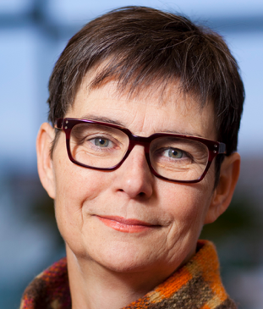
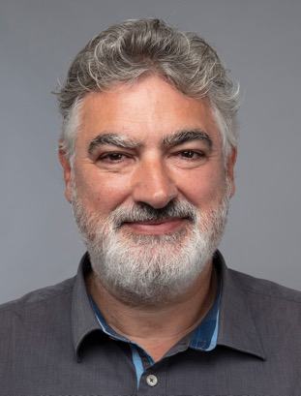
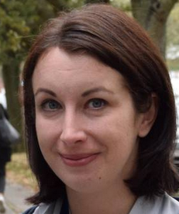
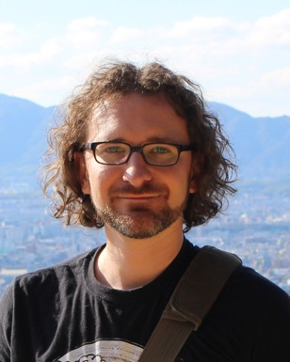
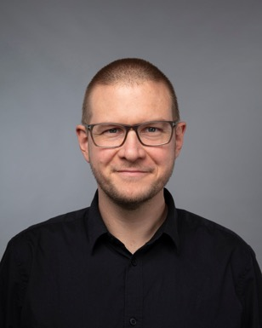
Who are we?
Permament academic staff:
Susanne Bødker (Professor)
Olav Bertelsen (Assoc. Professor)
Eve Hoggan (Assoc. Professor)
Michael Wessely (Assist. Professor)
Clemens Nylandsted Klokmose (Assoc. Professor)
Research
Education
Collaboration
Talent

Slide 3
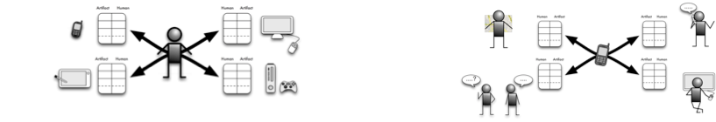
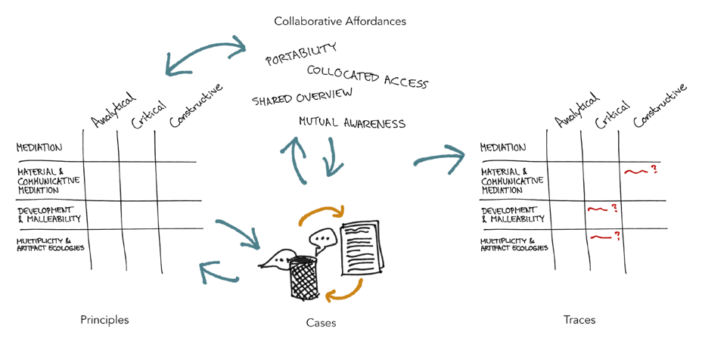
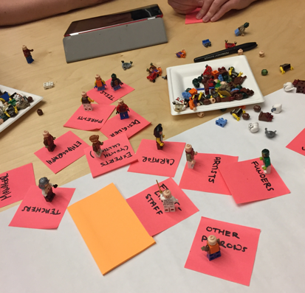
Mediation and Artifact ecologies
Activity theoretical HCI - Concepts, dynamics, methods of analyzing and designing for, building

Slide 4
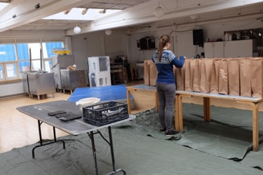
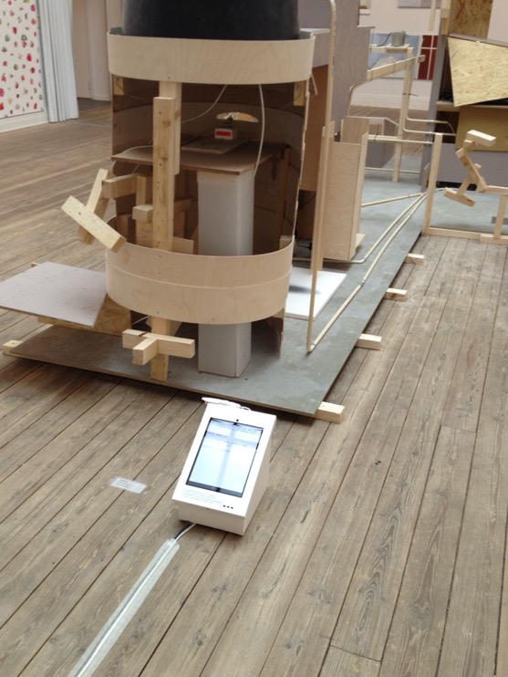
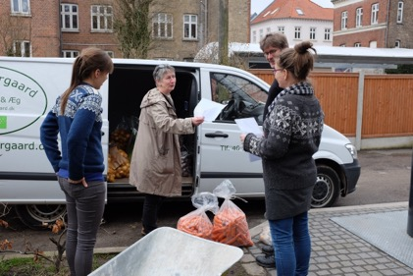
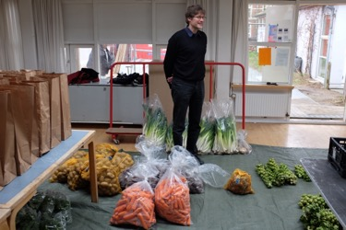
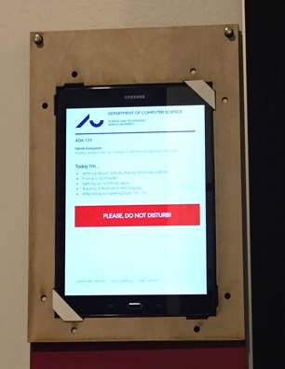
Communities and participation

Slide 5
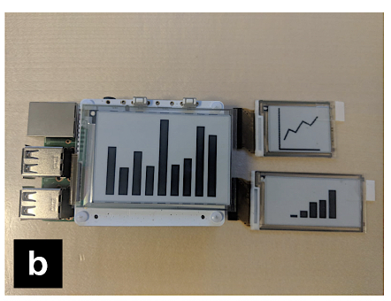
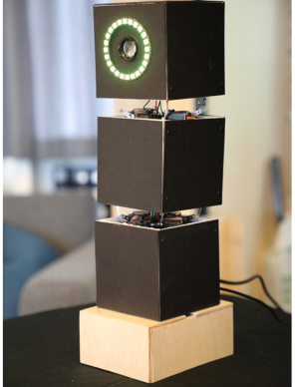
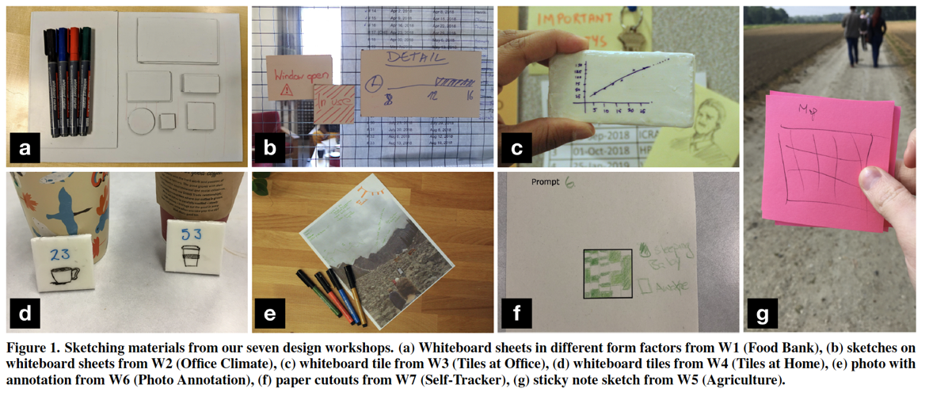
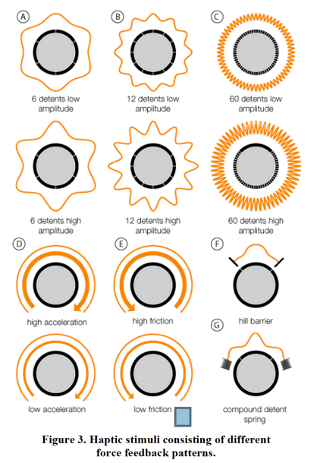
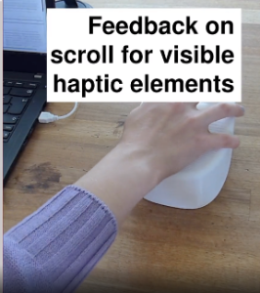
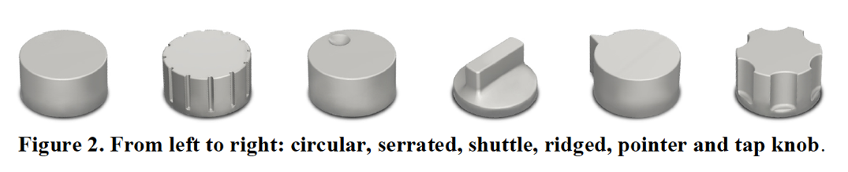
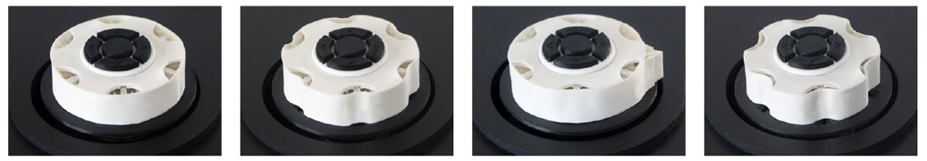
Tangibility, modalities and distributed interaction

Slide 6
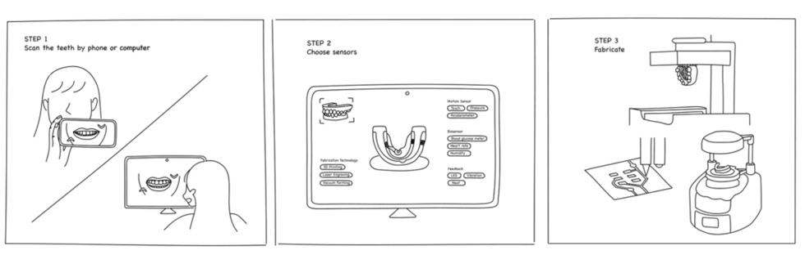
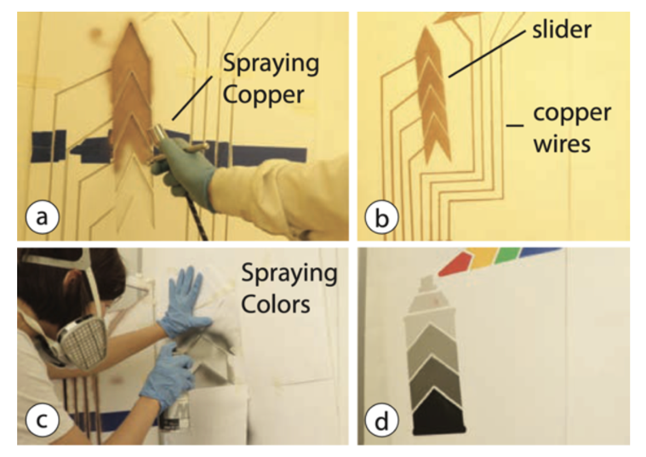
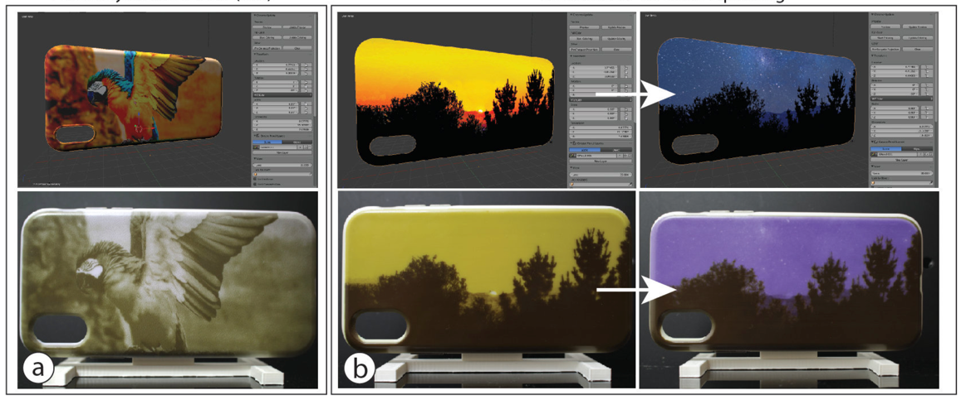
Fabricating interactive technologies

Slide 7
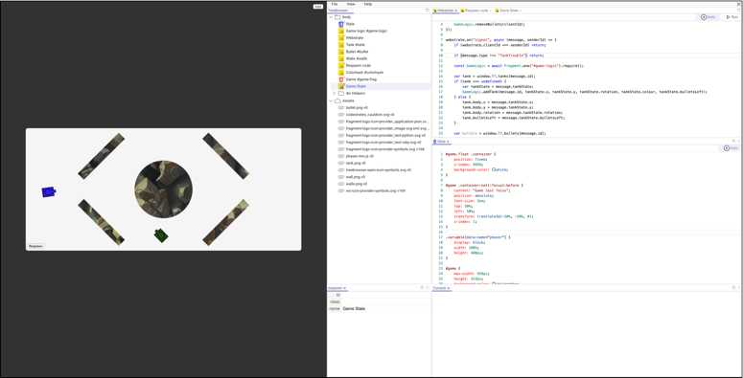
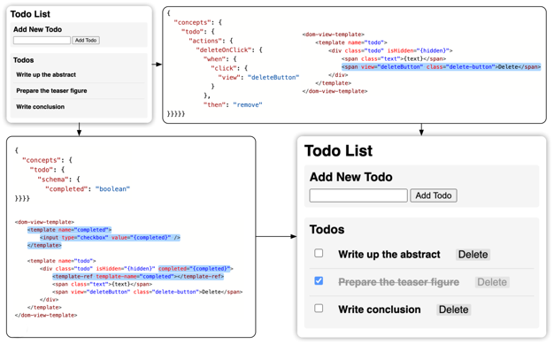
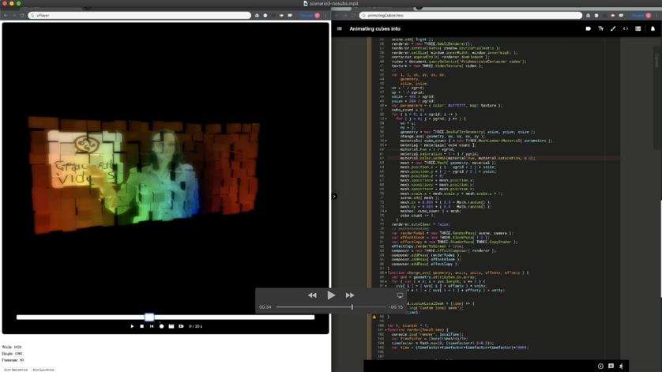
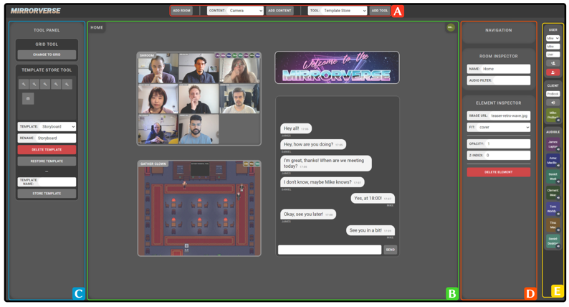
Computational media & Malleable software

Slide 8
Bachelor Project proposals in COCHI
Family stories, sharing of family trees and data quality, physically and/or through online platforms like MyHeritage (Susanne)
A Case study of an IT development project in an organization (Olav)
Fabricating large-scale user interfaces in architecture (Michael)
Fabricating In-mouth Interfaces (Michael)
Haptic textures in 3D printing (Michael)
LLMs in computational notebooks (Clemens)
Violations of personal digital sovereignty (Clemens)
Handling and versioning binary assets in a CRDT-based version of Webstrates (Clemens)

